Slide 1
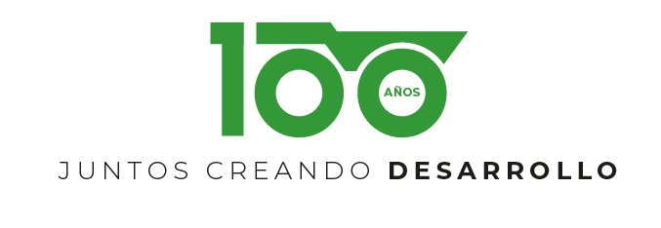
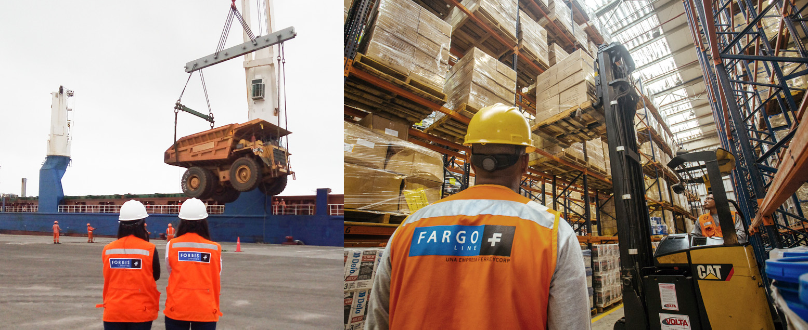
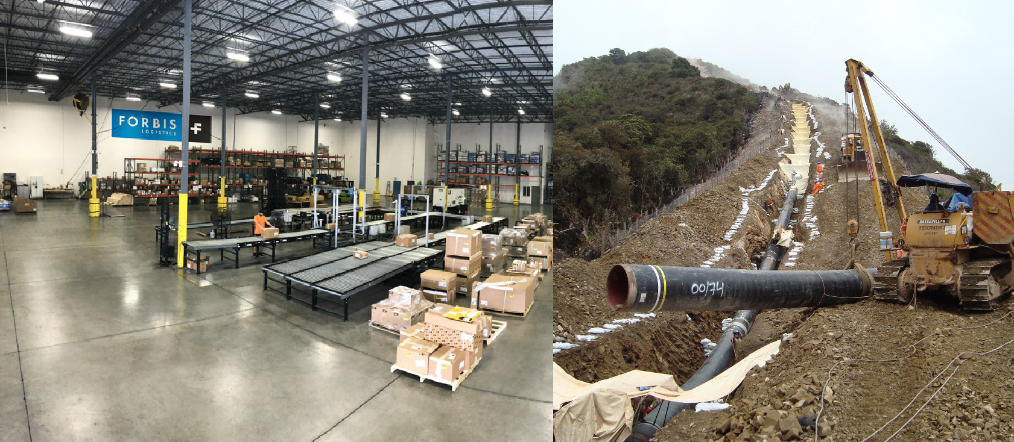
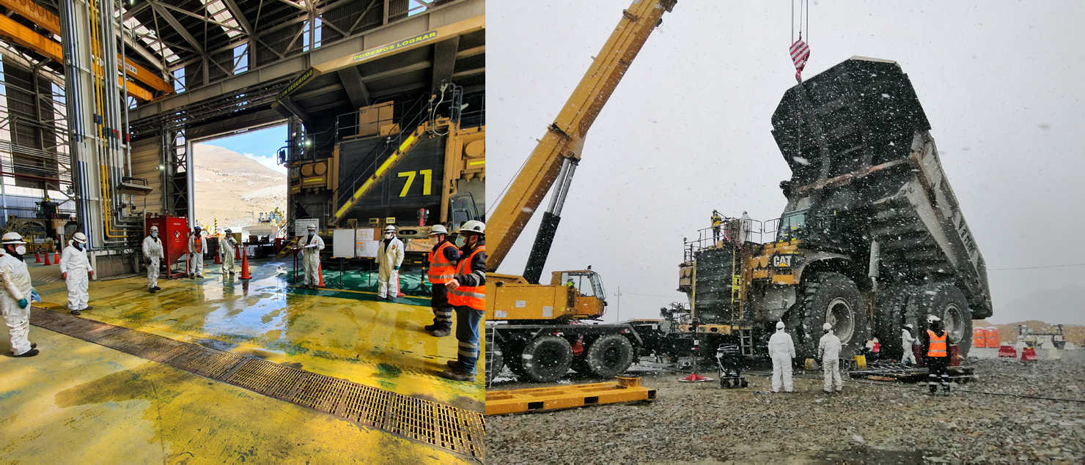
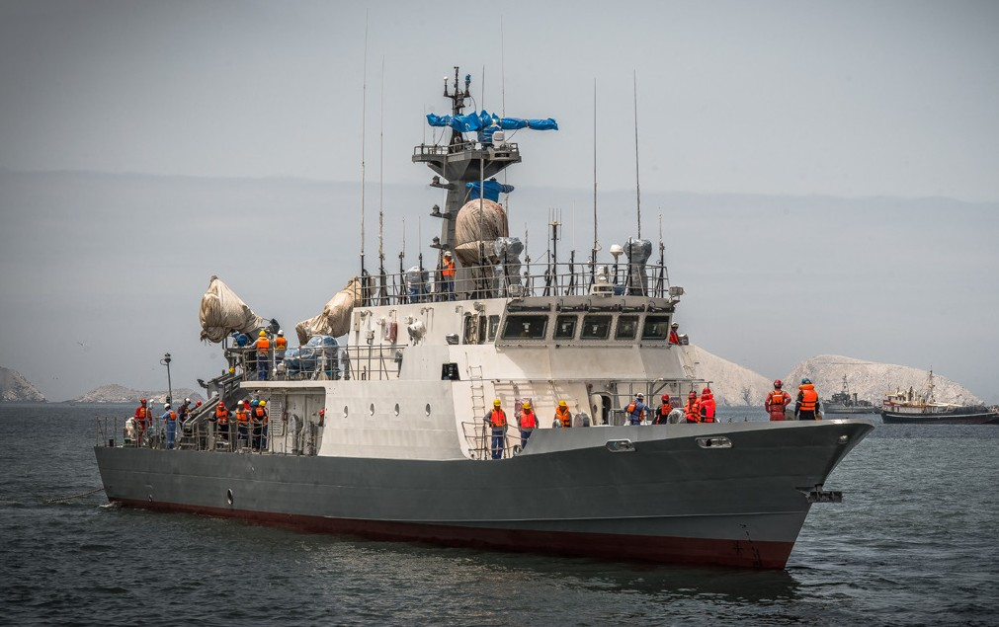
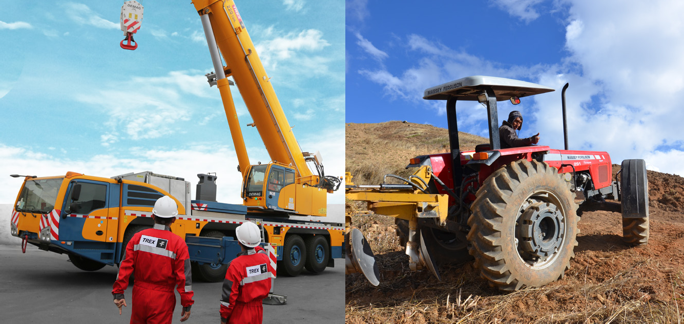
Corporate Presentation Ferreycorp
February 2023
hacemos posible el desarrollo de los lugares en los que estamos.
años,

Slide 2

Overview of the Company
Ferreycorp was established in 1922 focusing in commercialization of consumption products.
In 1942 , the company assumes the representation and strategic alliance with Caterpillar Tractor (almost 80 years ago) in Peru and entered the capital goods field.
In the same decade, aiming to achieve greater market coverage, began its decentralization and the expansion of its footprint: establishes offices in provinces as well as several subsidiaries.
In 2010 Ferreycorp acquired the Caterpillar dealers in Guatemala, El Salvador and Belize.
Brands other than Caterpillar in portfolio: Metso, Paus, Chevron, 3M, Good Year, Genie, Terex, Wacker, Carmix.
Ferreycorp is a proxy of the Peruvian economy and serves all economic sectors: mining, construction, agriculture, fishing, industry, commerce, telecom, oil, transportation.
Ferreycorp and its subsidiaries have 7,023 employees.

Slide 3
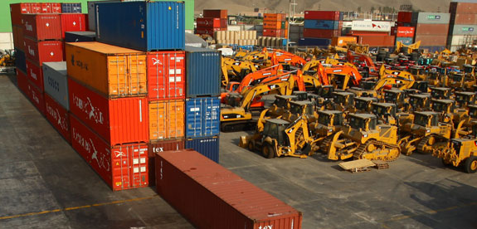
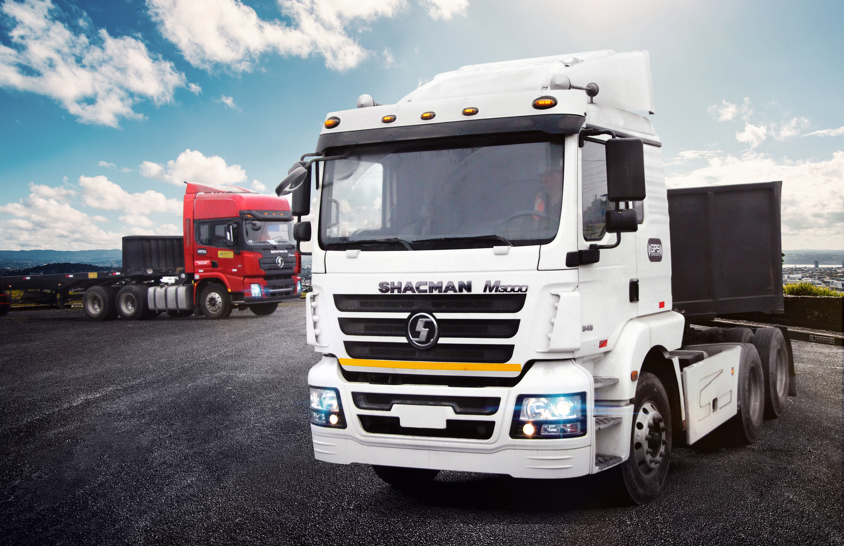
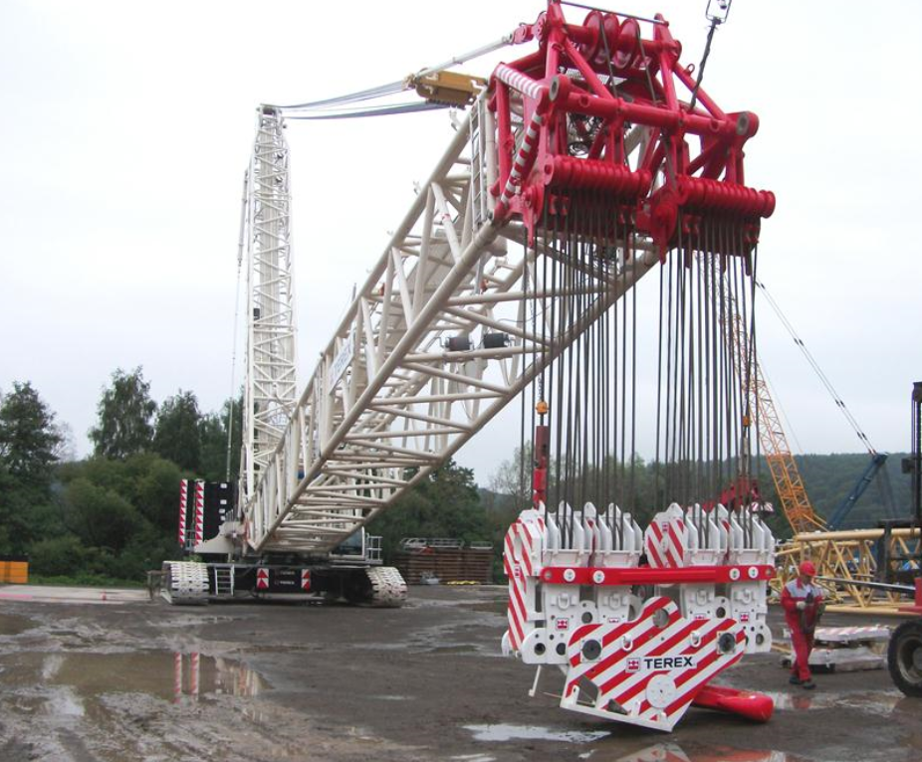
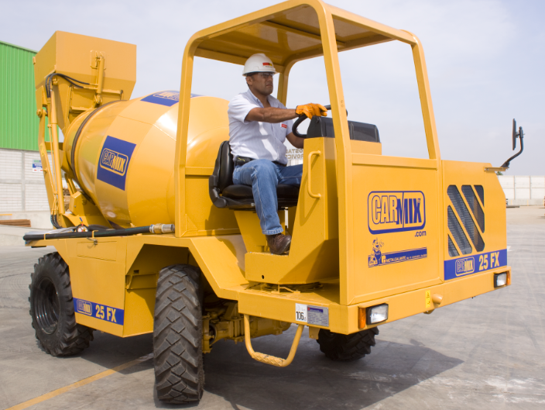
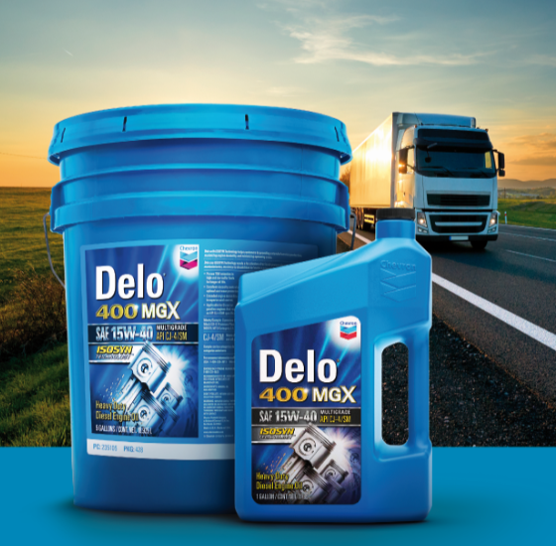
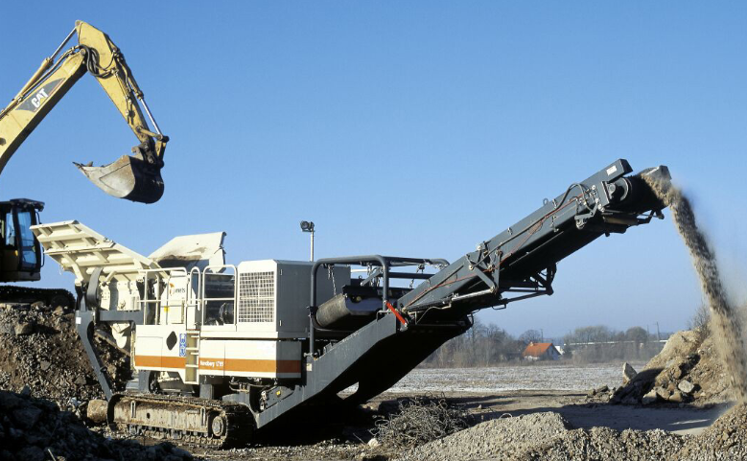
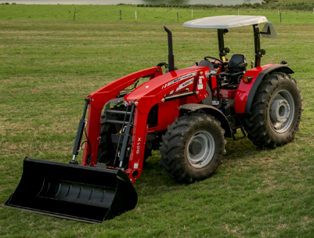
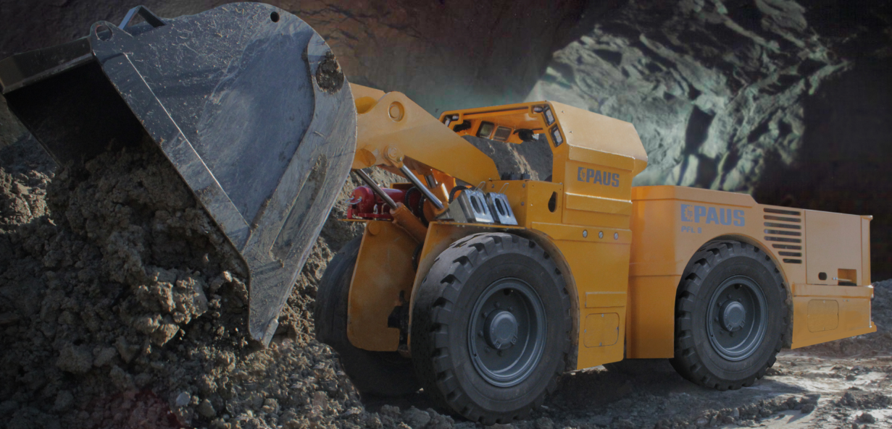
Portfolio Diversification
Thanks to the experience and knowledge acquired with Caterpillar, the corporation and its subsidiaries have established strong long-term relationships with a number of global brands. Ferreycorp has consolidated as a prestigious portfolio of represented brands, becoming the leader in its field.

Slide 4

Ferreycorp
Strategy and Capabilities

Slide 5
Corporation´s strategy
Business model
Role of Parent Company
Role of subsidiary companies
Shared services center
STRATEGIC COHERENCE
Business vision
Strategic planning and definition of the businesses to participate
Brands & Positioning
Human Resources
Control & Supervision
OPERATIONAL AUTONOMY
Customer proximity and market coverage
Business execution with operational excellence
Profitability and financial health
Business innovation and value proposition
Best practices and search for synergies
STANDARDIZATION AND EFFICIENCIES
Standardization of processes
Synergies & efficiencies
Non-core processes, back office: legal, audit, human resources, finance, IT.
Critical mass for better supplier conditions

Slide 6


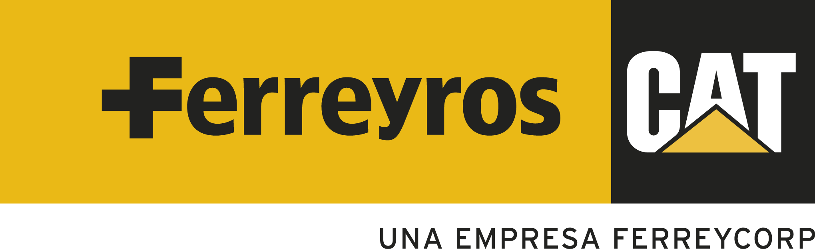

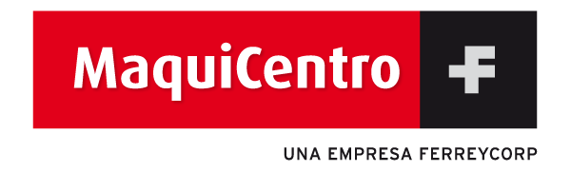




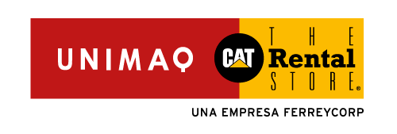




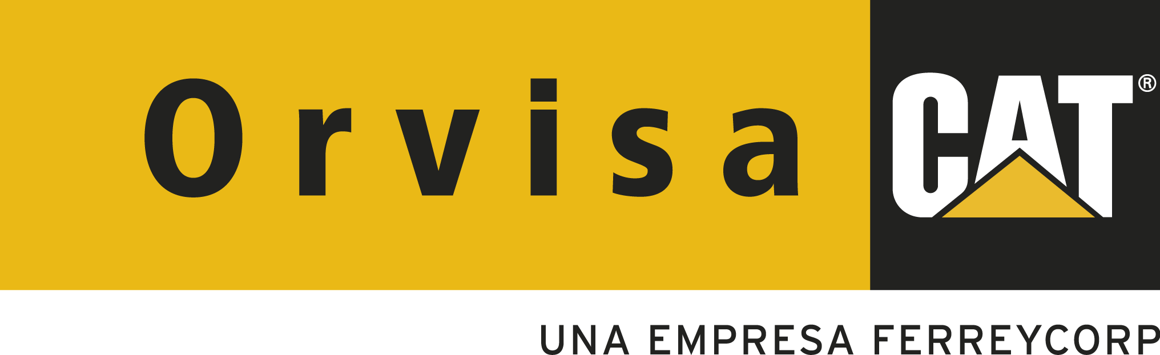
Corporate Structure
BVL: FERREYC1
Caterpillar Dealers and Allied Brands in Peru
Caterpillar Dealers and Other Businesses in Central America
Other Subsidiaries in Peru and Abroad
Chile, Colombia , Ecuador, Perú
Guatemala, Belice
...
El Salvador
El Salvador, Honduras

Slide 7
Results achieved by the organization
(S/. Million)
Caterpillar Dealers and Allied brands in Peru
Caterpillar Dealers and other businesses in Central America
Other Subsidiaries in Peru and Abroad
Sales
5,102
677
814
% of Total Sales
77.4%
10.3%
12.3%
EBITDA
748
91
80
% of Total EBITDA
81.4%
9.9%
8.7%
EBITDA Margin
14.7%
13.4%
9.8%
# of employees
5,247
1,023
753

Slide 8
Sales by Group of Subsidiaries
Sales by Group of Subsidiaries
(

Slide 9
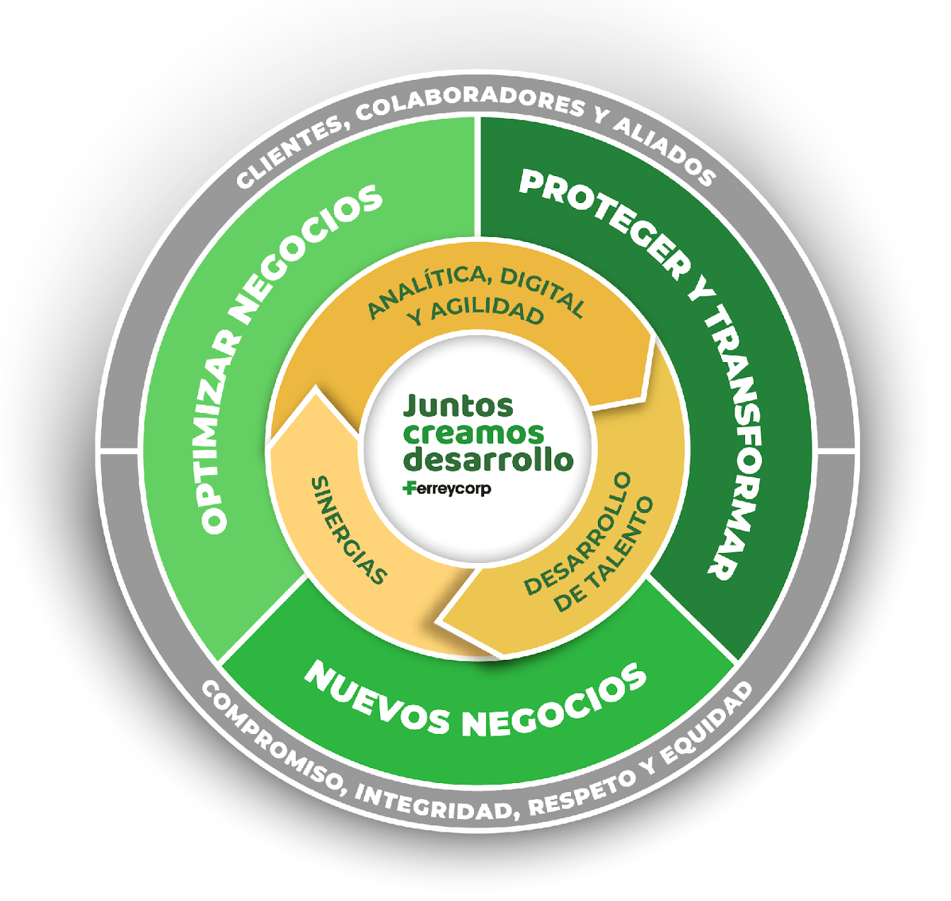
Ferreycorp Strategy
BUSINESS PILLARS
Optimize business | Seeks to add efficiencies in the business model, the organization, the use of assets, and the composition of products and services portfolio.
Protect & Transform | Ensure business sustainability, expand it´s value offer, and provide comprehensive solutions to customers supported by technology and best practices in operations.
New business | Development of new lines or businesses that have an adequate strategic fit with the current brand portfolio and that present the opportunity to obtain significant synergies (market, capabilities, economies of scale).
ENABLERS
Analytics, digital and agility | Development of Data Management and Analytics capabilities, transversal to the organization
Synergies | Maintain and continue developing commercial synergies. Value creation without losing segmentation and specialization. Shared services between companies.
Talent Development | Ongoing training and development to strengthen skills Have digital, analytical and agility capabilities Ensure alignment between performance and strategy

Slide 10
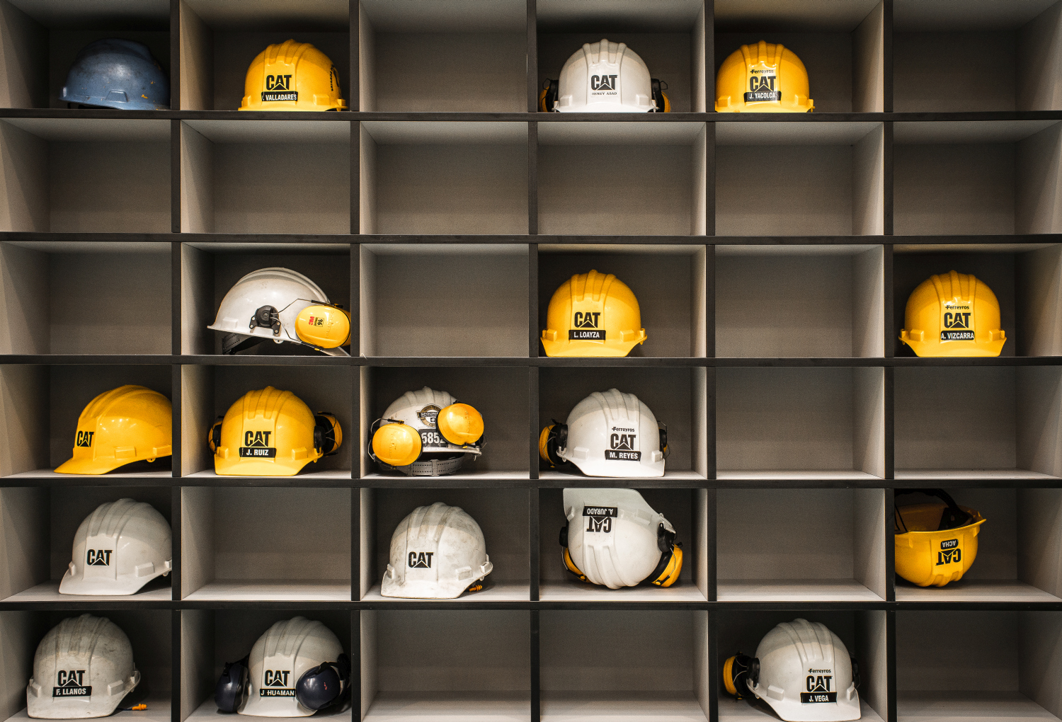
Key Capabilities developed over the years
Long-term strategic alliances. Access to best practices, Xcellence programs.
Market coverage
Unmatched supply chain and logistics capabilities
Excellence in after market with experienced technicians and accumulated data
Financial strength and funding sources
Innovation and technology
Ethics and compliance, Corporate Governance and Sustainability

Slide 11
With a strong market share in order to
take all the market opportunities
Open pit mining
Heavy construction
In Units
Rolling 12 mo, Dec 2022
US$ FOB
Rolling 12 mo, Dec 2022
Underground mining
General construction
US$ FOB
Rolling 12 mo, Dec 2022
US$ FOB
Rolling 12 mo, Dec 2022
Notes:
952204031

Slide 12
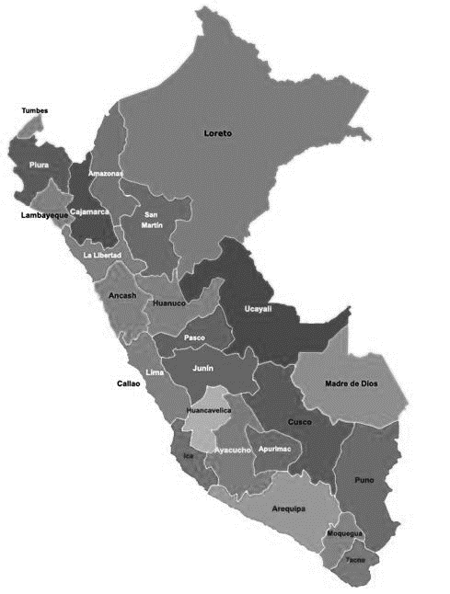
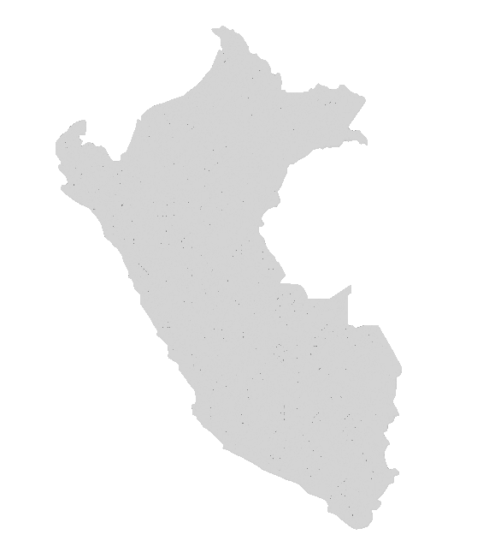
Supported by current
Mining customers: 50% of sales
Large Open Pit
Medium Size and Underground
Cerro Corona
La Zanja
Iscaycruz
Shahuindo
Raura (UG)
El Porvenir (UG)
Yanacocha
Islay (UG)
Atacocha (UG)
San Cristobal (UG)
Animon (UG)
Antamina
Uchucchacua
Carahuacra (UG)
Morococha
Iscaycruz
Toromocho
Yauliyacu
Andaychagua (UG)
Las Bambas
Mina Justa
Constancia
Cerro Lindo (UG)
Shougang
Antapaccay
San Rafael (UG)
Cerro Verde
Cuajone
Marcona
Quellaveco
Inmaculada (UG)
Toquepala
Pallancata (UG)
Pucamarca
12

Slide 13
Increasing Caterpillar mining trucks and shovels population over the years
Mining Investment
US$ Bn
Caterpillar Mining Trucks and Shovels Population
Units

Slide 14
Leverage our sales
Open Pit Mining Sales
Machines, Spare parts and Services
Mining Investment
US$ Bn
US$ Million
CAGR Spare Parts and Services: 9%
Source: Minem & Ferreyros

Slide 15
Resilient Business Model
Sales by Business Line
Spare parts and services support business.
Diversification strategy through business lines, presence in different economic sectors, different countries, various represented brands and a diversified portfolio of products related to capital goods.
US$ MM
US$
1.2 Bn
US$
1.9Bn
US$
1.8 Bn
US$
1.7Bn
US$
1.6Bn
US$
1.6 Bn
US$
1.6 Bn
US$
1.7 Bn
US$
1.2 Bn
US$
1.4Bn
US$
1.4Bn
US$
1.4 Bn
US$
1.2 Bn
US$
0.8Bn
US$
0.7Bn
-
(*) Other lines include: logistic businesses, lubricants and consumables.

Slide 16
Gross Margin Adj. 4Q2021 = 24.7%, 4Q 2022 = 25.1%
Operating Margin Adj. 4Q 2021 = 11.1% ; 4Q 2022 = 9.5%
Ebitda Margin Adj 4Q 2021 = 14.4% ; 4Q 2022 = 12.5%
Reflected in strong financial results
Million soles (S/ mm)
Sales
Margins
+8%
+10%
+6%
Operating Profit
EBITDA
-10%
-12%
-17%
-15%
-15%
-13%

Slide 17
NET INCOME
In Million Soles (S/ mm)
NET INCOME 4Q2022
Positive variations
Negative variations

Slide 18

Net Profit impacted by FX Loss
Net Profit, Margin and FX Loss
(In million S/)
FX Gain as of December 2022: S/ 33.5 million

Slide 19
Liquidity and working capital trends
Cash Balance
(In million US$)
Target: 50% - 50%
Debt Maturity
(In million US$)
Ratios | Mar-20 | Jun-20 | Set-20 | Dic-20 | Mar-21 | Jun-21 | Sep-21 | Dec-21 | Mar-22 | Jun-22 | Set-22 | Dec-22
Net debt / EBITDA | 3.35 | 4.05 | 3.19 | 2.64 | 2.48 | 2.31 | 2.15 | 1.78 | 1.60 | 1.99 | 2.28 | 2.30
Adj. Debt / EBITDA | 2.5 | 3.22 | 3.07 | 2.37 | 1.88 | 1.68 | 1.65 | 1.77 | 1.53 | 1.48 | 1.85 | 1.75
Debt
(In million US$)
896
899
863
857
682
717
741
698
583
586
538
511
505
548
526
560
566
496
472
483
448
472

Slide 20
Financial expenses and
controlled average cost of debt
Financial Expenses
(In million S/)
Average cost of debt

Slide 21
Controlling main assets and CAPEX
Account Receivables
(In million S/)
+26%
1,330
Capex
(In million US$)
1,221
1,147
1,055
1,036
31
38
29
43
25
12
Inventories
(In million S/)
+6.1%
2,082
2,208
1,772
1,944
1,684
Investment in intangible assets reached US$ 1.3 million dollars as of December 2022

Slide 22
Important Investment in Assets
Total Assets
(In million S/)
Cash Cycle
(Days)
+4%
Positive variations
Negative variations

Slide 23

Sustainability Program

Slide 24

SUSTAINABILITY
Positive Relations with all Stakeholders
Good Corporate Governance Principles
Respect for the rights of shareholders
Transparent and timely delivery of information
Effective representation through a Board of Directors
Ferreycorp Association.
Ferreyros’ Heavy Equipment Operators Club
Think Big Program
Youngsters with a future Program
“Works for taxes” program
Corporate volunteering
Health care, safety and working conditions
Training and professional development
Value and respect for diversity
Labor Inclusion Program
Personal & Family Gowth
Community
Shareholders
Long-term and mutually beneficial business relationships
High-quality products and services, specialized attention by sector.
Continuous monitoring of customer satisfaction and claims
Marketing & Com. policies
Clients
Employees
Government and Society
Environmental management system based on ISO 14001 Standard
Environmental Management Programs: planning, training and awareness, operational control and verification
Carbon Footprint Measurement
Environment
Suppliers
Sustainability Report
Global Compact Progress Report
Socially Responsible Company Distinctive
Recruitment policy: transparency and fair treatment
Preference for suppliers based on: quality of the product or service, price, terms of delivery, treatment to personnel, implementation of security programs.
ABE between providers
Committee of Carriers that share good practices

Slide 25
Dow Jones Results 2017-2022 by Dimension

Slide 27
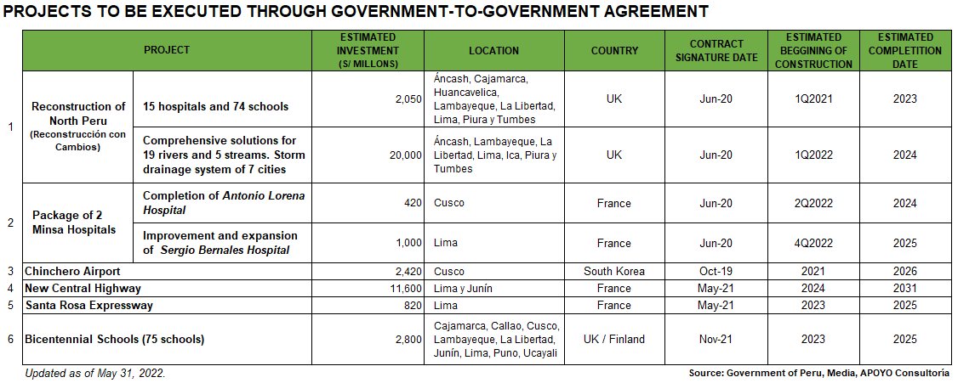
Public Investment focused on small projects mainly
managed by subnational goverments and G2G

Slide 28
Mining Sector Investments
Peru’s social conflicts, regulatory risks and low business confidence are constraining investments in the country’s mining sector and reducing its growth

Slide 29
Mining Sector Investments

