Slide 1
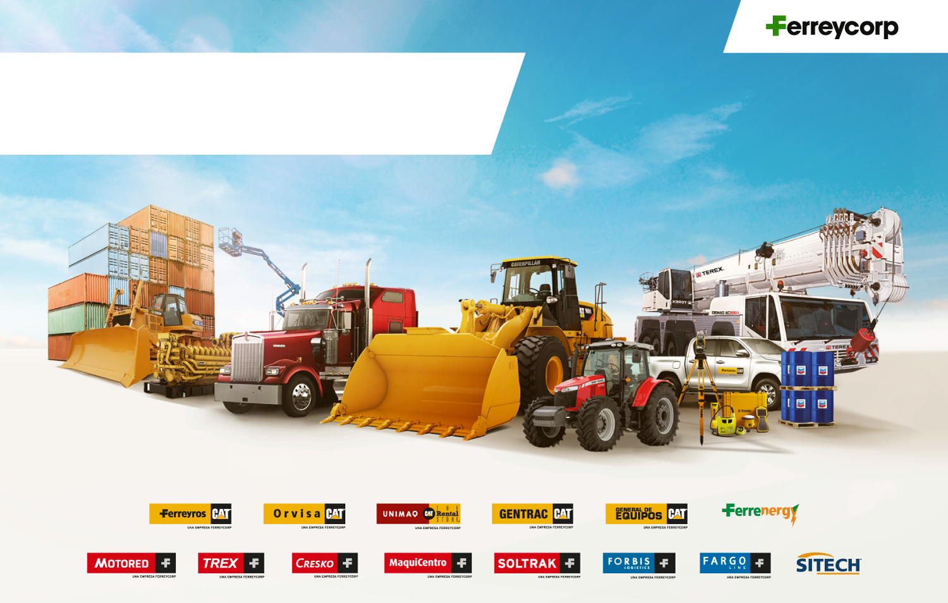
Ferreycorp
Jun-22

Slide 2
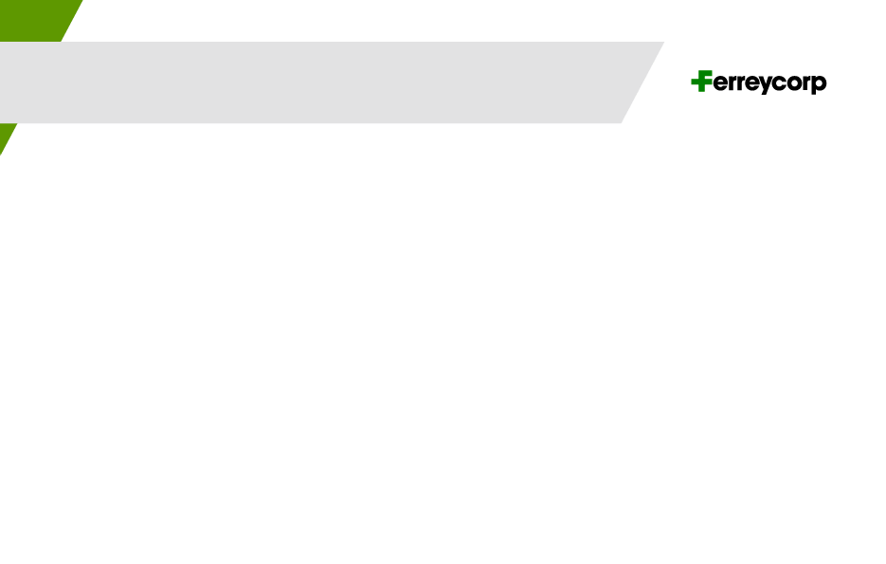
Insufficient availability of equipment/spare parts
Constant support and coordination with factory reps and special discounts to avoid losing PINS (market share) and thereby reduce the impact of running out of existing equipment.
Prime and parts: make purchase orders in advance.
Coordinate directly with Forbis (our logistic subsidiarie) the advance reservation of ships and airplanes.
Support with other dealers in the region to exchange products.
Reuse parts with customer acceptance.
Special bonuses for waiting time (Equipment rental – Spare parts bonuses).
Import of used equipment with few hours.

