Slide 1
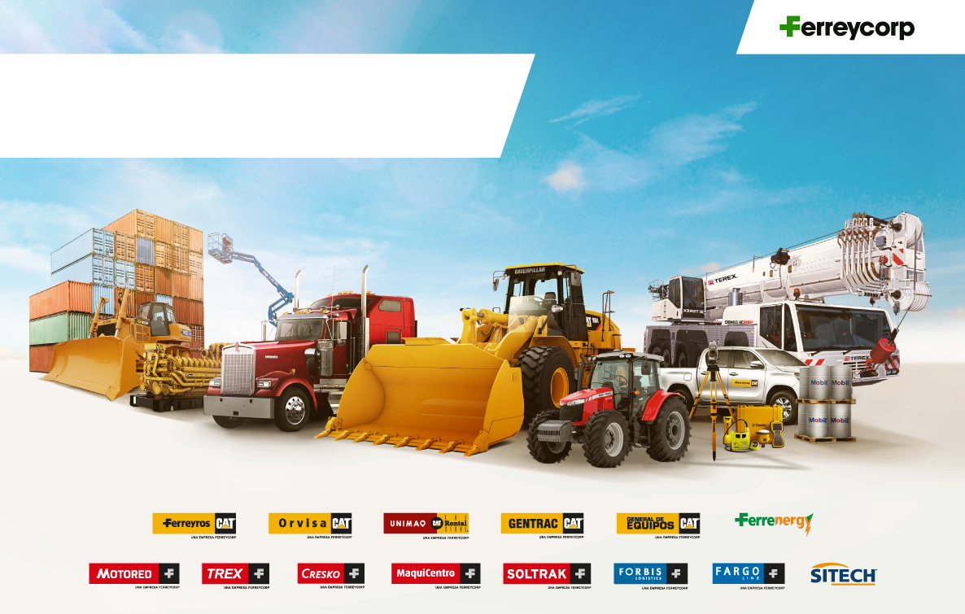
Earnings Presentation
First Quarter 2022
April 2022

Slide 2
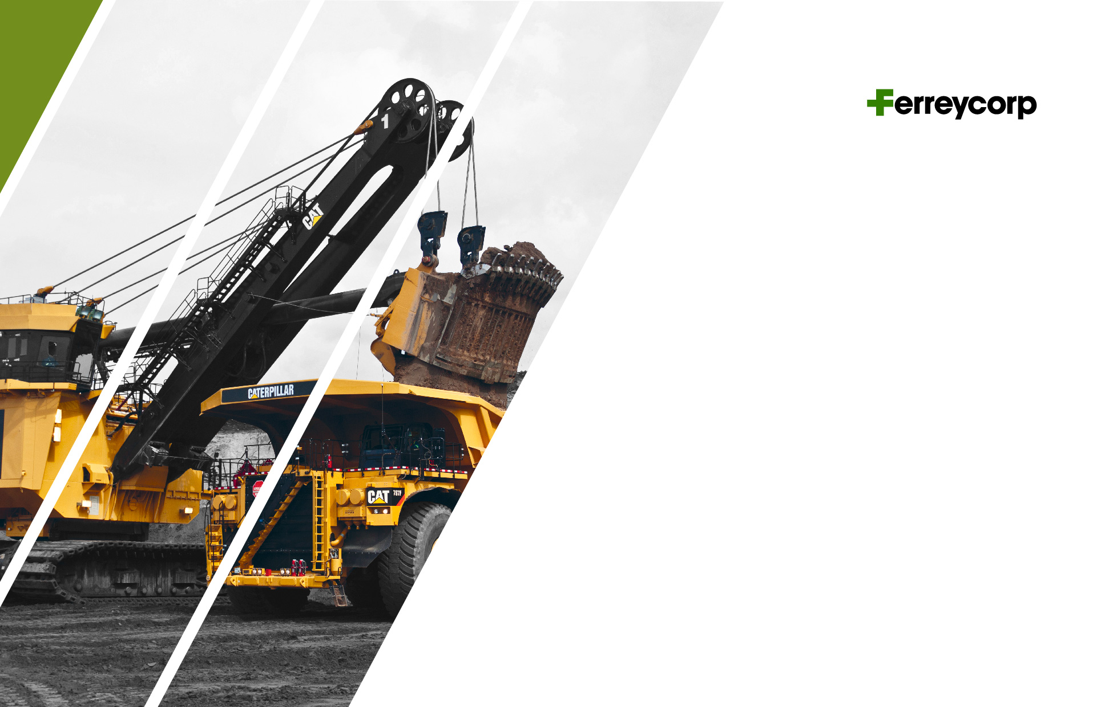
Agenda
1. Introduction
2. 1Q2022 Financial Highlights
3. Commercial Performance
4. Financial Results

Slide 3

Introduction

Slide 4

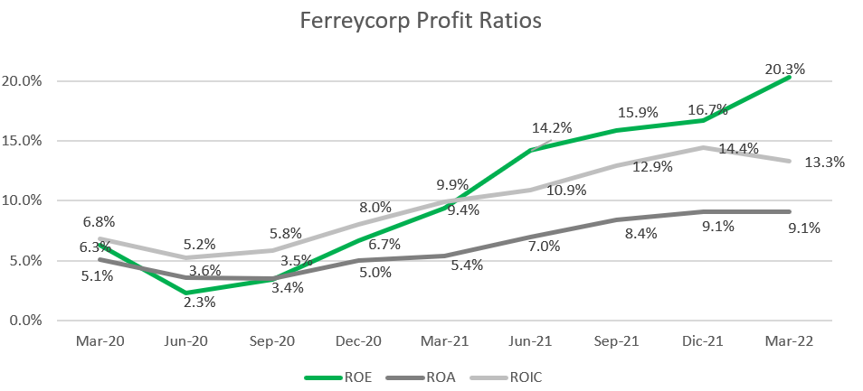
INTRODUCTION

Slide 5
INTRODUCTION
GDP
(Var %)
PUBLIC AND PRIVATE INVESTMENT
(Var %)
Private investment affected in 2022 by business confidence
Mining and Construction GDP evolution
(Var %)
Sources: Central Bank Inflation Report as of March 2022 & Apoyo

Slide 6
INTRODUCTION

Slide 7
HIGHLIGHTS
Dividends´ payment
On March 2022, the Shareholders´ Meeting approved a cash dividend of S/225.6 million.
This amount was defined by the upper limit of the dividend policy (60% of free disposal profits)
On October 2021 an advance cash dividend of S/100 million was paid.
The remaining amount to be paid is S/ 125.6 million, equivalent to thirteen cents per share (S/ 0.1310).
Payment date: May 4, 2022 (the record day was April 20th).
Amortization of treasury
The shareholder´s Meeting approved the amortization of 12.8 million treasury shares and subsequent capital reduction.
As of now we have no more treasury shares.
The repurchase program is still active.

Slide 8

2. 1Q2022 Financial Highlights

Slide 9
Gross Margin Adj. 1Q 2022 = 25.5% ; 1Q2021 = 26.3%
Operating Margin Adj. 1Q 2022 = 9.4% ; 1Q 2021 = 9.6%
Ebitda Margin Adj 1Q 2022 = 13.3% ; 1Q 2021 = 14.1%
FINANCIAL HIGHLIGHTS
Million Soles (S/ mm)
SALES
MARGINS
+4%
+21%
+19%
OPERATING PROFIT
EBITDA
-11%
-11%
+11%
+24%
+8%
-14%

Slide 10
FINANCIAL HIGHLIGHTS
Million Soles (S/ mm)
NET INCOME 1Q2022
Positive variations
Negative variations

Slide 11


3. Commercial Performance

Slide 12
SALES BY BUSINESS LINES
Million Soles (S/ mm)
CAT MINING EQUIPMENT
CAT MACHINES AND ENGINES
+4%
+98%
+11%
+40%
+40%
+17%
SPARE PARTS AND SERVICES
RENTAL AND USED
-3%
+12%
+4%
+23%
+10%
+2%

Slide 13

4. Financial Results

Slide 14
CASH GENERATION AND LIABILITY MANAGEMENT
Million Dollars (US$ mm)
252
CASH BALANCE
DEBT MATURITY AND PROFILE
DEBT EVOLUTION
896
857
899
731
863
711
696
669
538
497
511
506
472
483
448
479

Slide 15
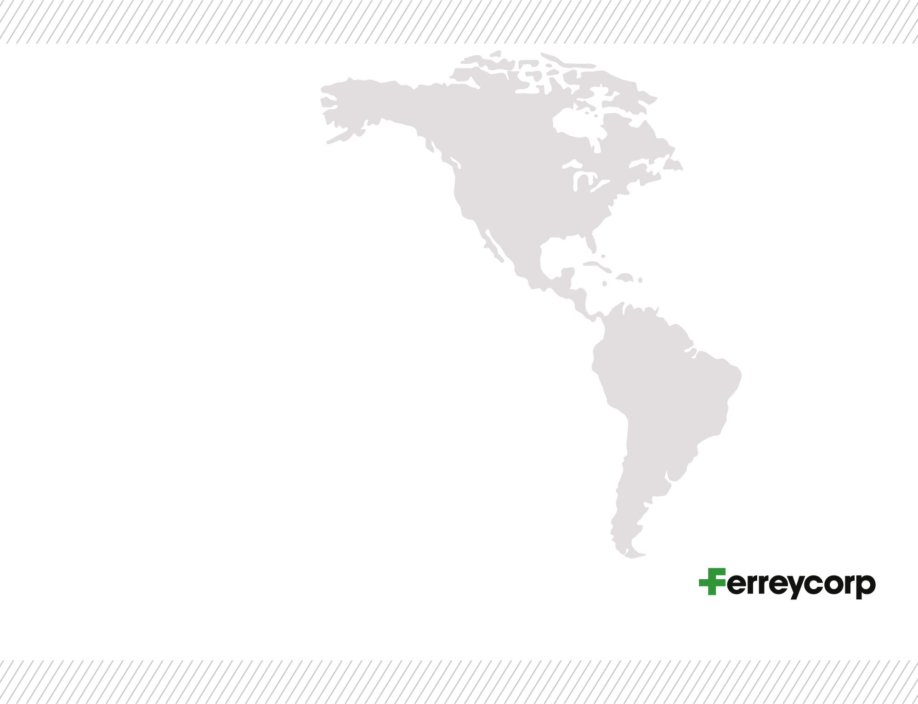

FINANCIAL RESULTS
Million Soles (S/ mm)
STATE OF FINANCIAL POSITION
CASH CYCLE
4%
Positive variations
Negative variations

Slide 16
CAPEX
Million Dollars (US$ mm)
CAPEX – FIXED ASSETS
43
29
38
25
10
12
Investment in intangible assets reached US$ 1.8 million dollars as of March 2022

Slide 17


