Slide 1
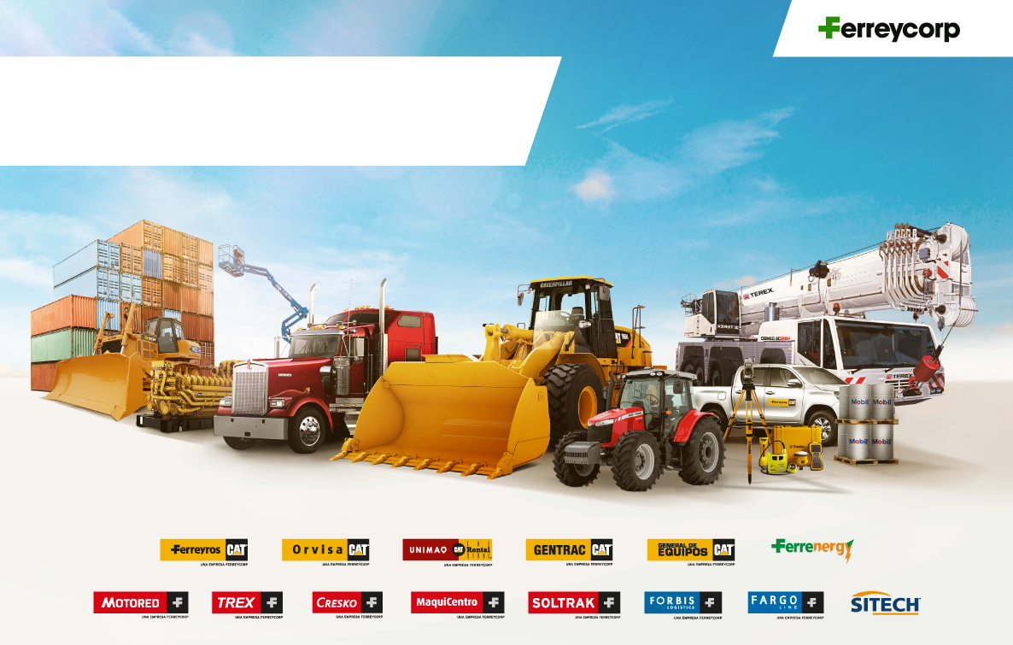
Earnings Presentation
Fourth Quarter 2022
February 2023

Slide 2

INTRODUCTION

Slide 3
INTRODUCTION
GDP
(Var %)
PUBLIC AND PRIVATE INVESTMENT
(Var %)
Private investment affected in 2022 by business confidence and less impulse of self-construction
Mining and Construction GDP evolution
(Var %)
Sources: Central Bank Inflation Report as of December 2022 & Apoyo

Slide 4
INTRODUCTION

Slide 5
Gross Margin Adj. 4Q 2021 = 24.7%, 4Q 2022 = 25.1%
Operating Margin Adj. 4Q 2021 = 11.1% ; 4Q 2022 = 9.5%
Ebitda Margin Adj 4Q 2021 = 14.4% ; 4Q 2022 = 12.5%
FINANCIAL HIGHLIGHTS
Million Soles (S/ mm)
SALES
MARGINS
+8%
+11%
+6%
OPERATING PROFIT
EBITDA
-10%
-12%
-17%
-15%
-15%
-13%
Notes:
3q2021 2q22 3q22 | YTD 2021 YTD2022

Slide 6
SALES BY BUSINESS LINES
Million Soles (S/ mm)
CAT MINING EQUIPMENT
CAT MACHINES AND ENGINES
-15%
+16%
+64%
-8%
+53%
+28%
SPARE PARTS AND SERVICES
RENTAL AND USED
+12%
+8%
-3%
-16%
+9%
-9%

Slide 7
Gross Margin Adj. 4Q 2021 = 24.7%, 4Q 2022 = 25.1%
Operating Margin Adj. 4Q 2021 = 11.1% ; 4Q 2022 = 9.5%
Ebitda Margin Adj 4Q 2021 = 14.4% ; 4Q 2022 = 12.5%
FINANCIAL HIGHLIGHTS
Million Soles (S/ mm)
SALES
MARGINS
+8%
+11%
+6%
OPERATING PROFIT
EBITDA
-10%
-12%
-17%
-15%
-15%
-13%
Notes:
3q2021 2q22 3q22 | YTD 2021 YTD2022

Slide 8
NET INCOME
Million Soles (S/ mm)
NET INCOME 4Q2022
Positive variations
Negative variations

Slide 9
CASH GENERATION AND LIABILITY MANAGEMENT
Million Dollars (US$ mm)
CASH BALANCE
DEBT MATURITY AND PROFILE
DEBT EVOLUTION
Notes:
Esto lo da Tesorería.

Slide 10


TOTAL ASSETS AND CASH CYCLE
Million Soles (S/ mm)
STATE OF FINANCIAL POSITION
CASH CYCLE
+4%
Positive variations
Negative variations

Slide 11
CAPEX
Million Dollars (US$ mm)
CAPEX – FIXED ASSETS
43
38
32
29
25
12
Investment in intangible assets reached US$ 1.3 million dollars as of December 2022
Disclaimer: Capex figures mentioned in the presentation used in the conference call had a mistake. This slide contains the correct numbers.

Slide 12


