Slide 1

Earnings Presentation
Second Quarter 2022
August 2022

Slide 2
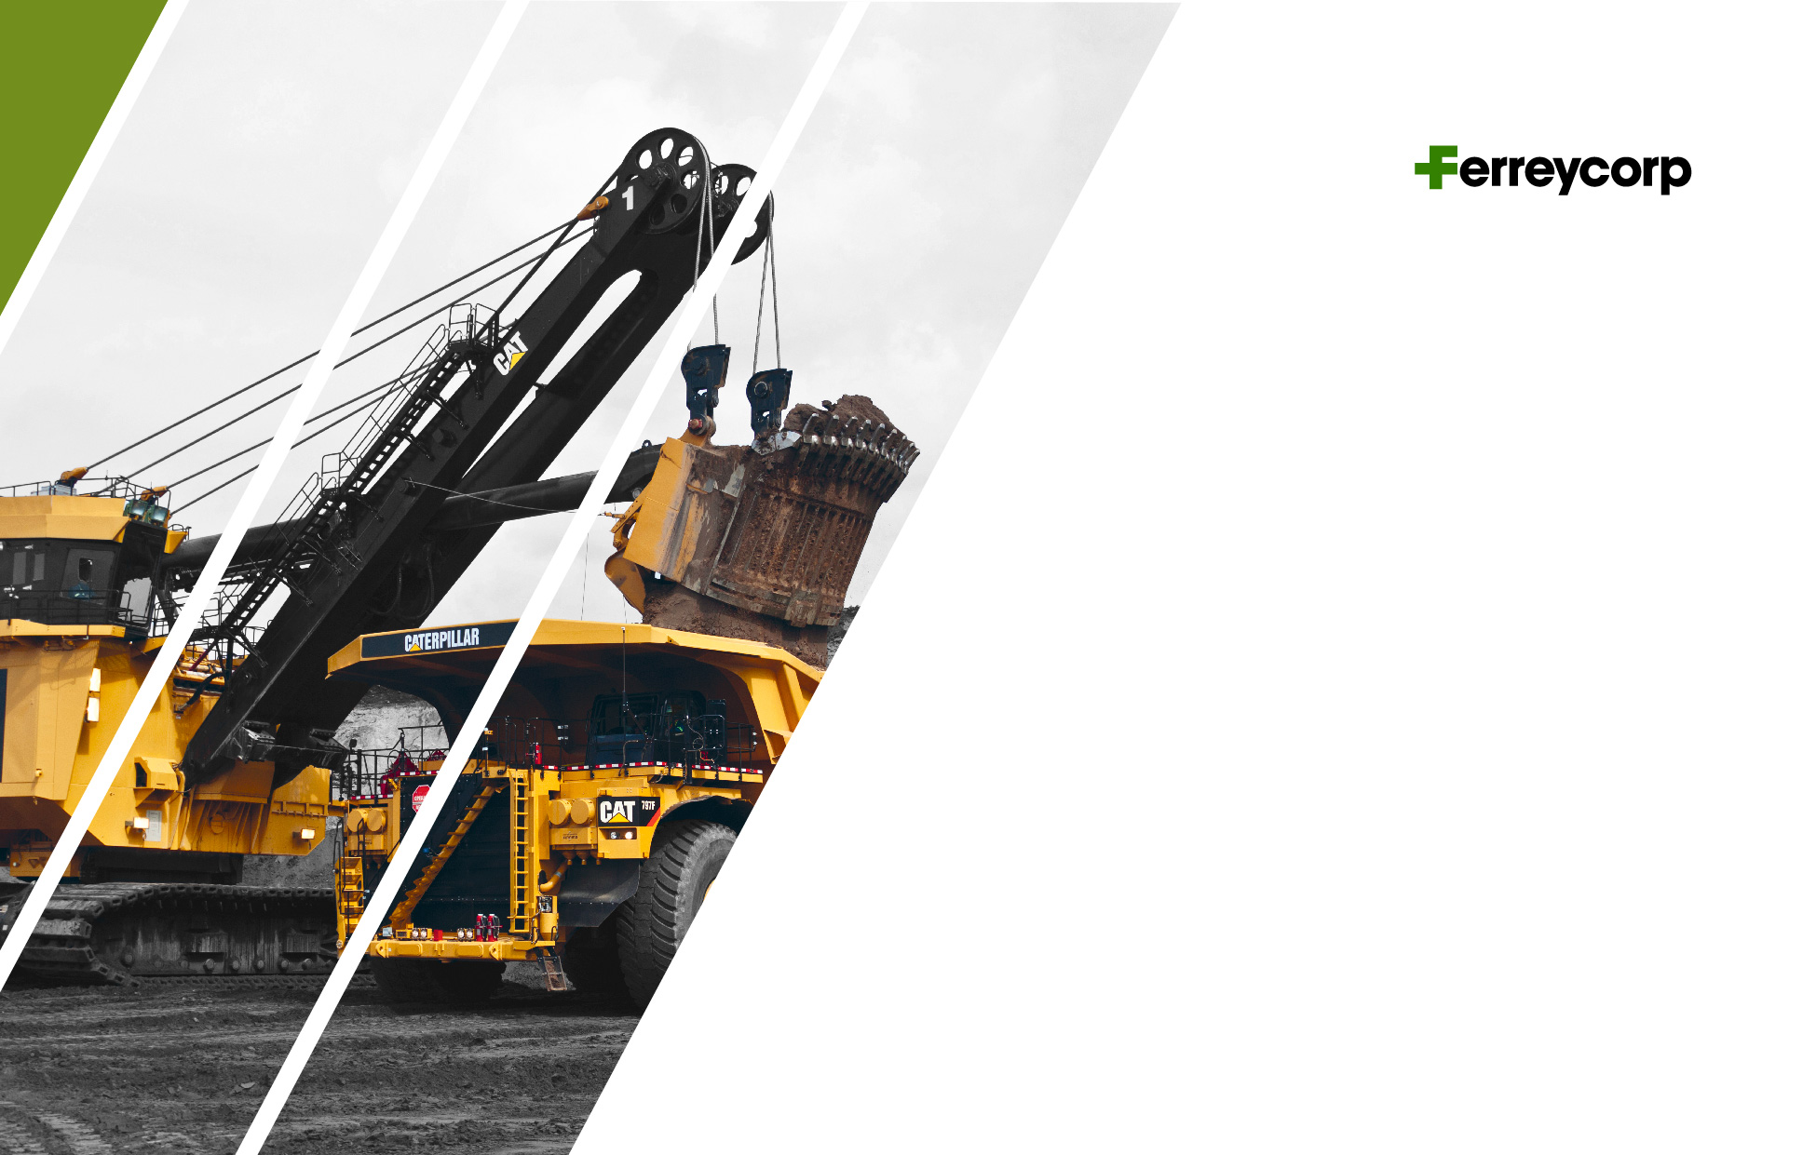
Agenda
1. Introduction
2. Commercial Performance
3. Financial Results

Slide 3

Introduction

Slide 4

INTRODUCTION

Slide 5
INTRODUCTION
GDP
(Var %)
PUBLIC AND PRIVATE INVESTMENT
(Var %)
Private investment affected in 2022 by business confidence
Mining and Construction GDP evolution
(Var %)
Sources: Central Bank Inflation Report as of March 2022 & Apoyo

Slide 6
INTRODUCTION

Slide 7
HIGHLIGHTS
Dividends´ payment
On March 2022, the Shareholders´ Meeting approved a cash dividend of S/225.6 million.
This amount was defined by the upper limit of the dividend policy (60% of free disposal profits).
On October 2021 an advance cash dividend of S/100 million was paid.
The remaining S/125.6 million were paid in May 4th 2022.
Sale of Punta Negra facility
This facility was acquired in 2015.
The selling price was S/95 million.
Decision aligned with strategy to optimize existing facilities and take advantage of synergies among the corporations’ subsidiaries.

Slide 8


2. Commercial Performance

Slide 9
SALES BY BUSINESS LINES
Million Soles (S/ mm)
CAT MINING EQUIPMENT
CAT MACHINES AND ENGINES
-70%
-89%
-5%
+11%
+40%
+27%
SPARE PARTS AND SERVICES
RENTAL AND USED
-29%
-16%
-31%
+6%
-6%
+19%

Slide 10

3. Financial Results

Slide 11
Gross Margin Adj. 2Q2021 = 26.2%, 2Q 2022 = 26.1%
Operating Margin Adj. 2Q 2021 = 11.8% ; 2Q 2022 = 11.4%
Ebitda Margin Adj 2Q 2021 = 15.8% ; 2Q 2022 = 15.1%
FINANCIAL HIGHLIGHTS
Million Soles (S/ mm)
SALES
MARGINS
-18%
-15%
+9%
OPERATING PROFIT
EBITDA
-53%
-41%
-58%
-16%
-48%
-12%

Slide 12
NET INCOME
Million Soles (S/ mm)
NET INCOME 2Q2022
Positive variations
Negative variations

Slide 13
CASH GENERATION AND LIABILITY MANAGEMENT
Million Dollars (US$ mm)
CASH BALANCE
252
DEBT MATURITY AND PROFILE
DEBT EVOLUTION
896
857
899
731
863
711
696
669
497
538
511
483
506
472
448
479

Slide 14


TOTAL ASSETS AND CASH CYCLE
Million Soles (S/ mm)
STATE OF FINANCIAL POSITION
CASH CYCLE
-1%
Positive variations
Negative variations

Slide 15
CAPEX
Million Dollars (US$ mm)
CAPEX – FIXED ASSETS
43
19
29
38
25
12

Slide 16


