Slide 1
Security of Information
Jun-22

Slide 2
1. Risks related to information systems
The main risks related to information systems for Ferreycorp are:
Interruption of business operations
Fraudulent operations
Leak or loss of sensitive information
Legal, Regulatory and Reputational Compliance
Events associated with the Interruption of business operations due to IT and environmental threats:
Prime & Rentals
Spare parts
Workshop and Field Services
Specialized Workshop Services
Logistics
Industrial Fuels
Accounting
Financial services
Human Resources
.
Events associated with illegal activities or dishonest practices that harm the Corporation's companies. Includes: deception, counterfeiting, fraud, etc
Appropriation of money
Inventory appropriation
Payments to suppliers
Employee payments
Client payments
Eventos asociados a la salida no controlada de información hacia personas y/o empresas no autorizadas.
Información Estratégica
Información de Productos y Servicios
Información sobre Cotizaciones
Información Técnica
Información Financiera
Información de Comercial
Información de Recursos Humanos
Events associated with contractual breach with partners, legal requirements and negative exposure of the Corporation's brands.
Fines and penalties.
Damage to image and reputation

Slide 3
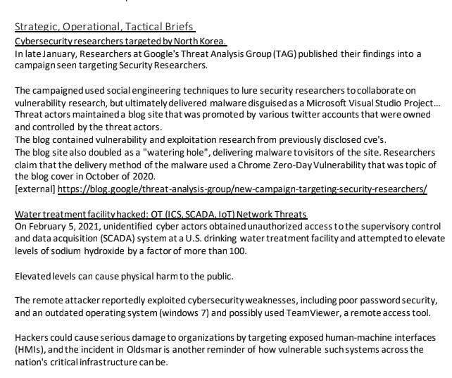
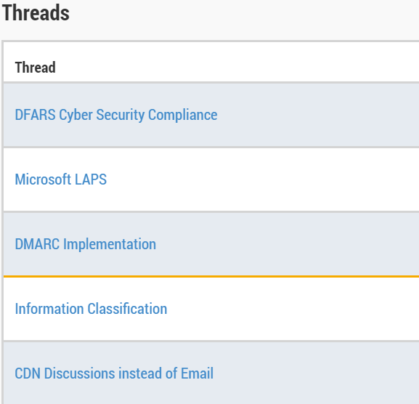
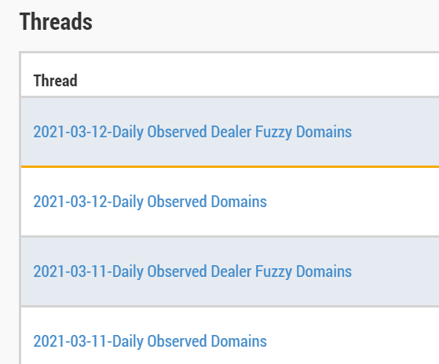
2. Scope of the Information Security Management System
Dealer Intelligence Network (DIN)
We are part of the DIN, whose purpose is to share cyber threats of interest to Caterpillar and its dealers. The objectives of the DIN are:
Reduce the impact of threats and proactively protect our organizations
Share data and intelligence, which allows us to implement security controls.
Reveal common trends, patterns, and threats.
News about Cybersecurity
DIN Meet
Best Practices
Threats and vulnerabilities

Slide 4
3. Information Security Management Model
Information Security Government
40
2. Personnel Safety
1. Policies, Organization and Compliance
Risk Management
4. Incident Management
5. Relationship with Suppliers
30
Specific Business Controls
6. Interruption of Business Operations
7. Prevention of fraudulent business operations
8. Leakage of sensitive information
9. Legal, Regulatory Compliance and Reputation
95
Controles Generales de TI
10. Endpoints
11. Networks and Internet
12. Servers
13. Google
14. Applications
15. Cloud Services
Total N° of controls
165
N° of controls related to cybersecurity
67

Slide 5
4. Information Security Management plans
2021 results: greater than 90%
ID | Plan de Seguridad 2021 | Tipo de Iniciativa | Prioridad | Riesgo Interrupción | Riesgo Fraude | Riesgo de Fuga de Información | Riesgo de Cumplimiento | Ciberseguridad
Gobierno de Seguridad de Información
G1 | Actualización de políticas | Servicio | 3 |  |  |  | X
G2 | Gestión de Auditorias y Evaluaciones | Servicio | 2 |  |  |  | X | X
G3 | Material de capacitación en Seguridad | Servicio | 3 |  | X | X | X | X
G4 | Hacking ético | Servicio | 2 | X |  | X |  | X
G5 | Scaneo de Vulnerabilidades + Proceso | Servicio | 2 | X |  | X |  | X
G6 | Gestión de Incidentes | Servicio | 3
G7 | Relación con proveedores | Servicio | 3 | X |  |  | X
Controles Específicos de Negocio
N1 | Plan de Continuidad de Negocios | Proyecto | 1 | X |  |  |  | X
N2 | Reglas de SoD - Catalogo | Servicio | 3 |  | X
N3 | Monitoreo de Segregación de Funciones | Proyecto | 3 |  | X
N4 | Prevención de Fuga de Información | Servicio | 3 |  |  | X
N5 | Cumplimiento de Ley de PDP | Servicio | 3 |  |  |  | X
N6 | Roles y Cuentas Privilegiadas de TPI | Servicio | 4 |  | X
Controles Generales de TI
T1 | Monitoreo de Seguridad - SOC | Proyecto | 1 | X | X | X |  | X
T2 | Antimalware en celulares | Servicio | 2 | X | X | X |  | X
T3 | Accesos privilegiados en Servidores | Servicio | 2 | X |  | X |  | X
T4 | Revisión Seguridad Google | Servicio | 3 |  |  | X |  | X
T5 | Remediar vulnerabilidades app web | Proyecto | 2 | X |  | X |  | X
T6 | Estabilización SAP Hana - Enero-Junio 2021 | Proyecto | 1
T7 | Soporte al Modelo de Roles SAP (Nivel 3) | Servicio | 3 |  | X
T8 | Soporte a Usuarios SAP (Nivel 2) | Servicio | 3 |  | X
T9 | Seguridad Accesos BI | Servicio | 4 |  | X
T10 | Trazabilidad de Accesos SAP | Servicio | 3 |  | X |  | X
T11 | Modelo de Roles de RRHH | Proyecto | 4 |  |  | X | X
T12 | Revisión de Seguridad en Proyectos TPI | Servicio | 4 | X | X | X | X
T13 | Atención de Incidentes de Seguridad | Servicio | 3 | X |  | X |  | X

